Slide 1
uFixit
The Future of User Manuals
12.07.2016
Manuel Kimmel, Stefan Urban, Firas Zoghlami

Slide 2
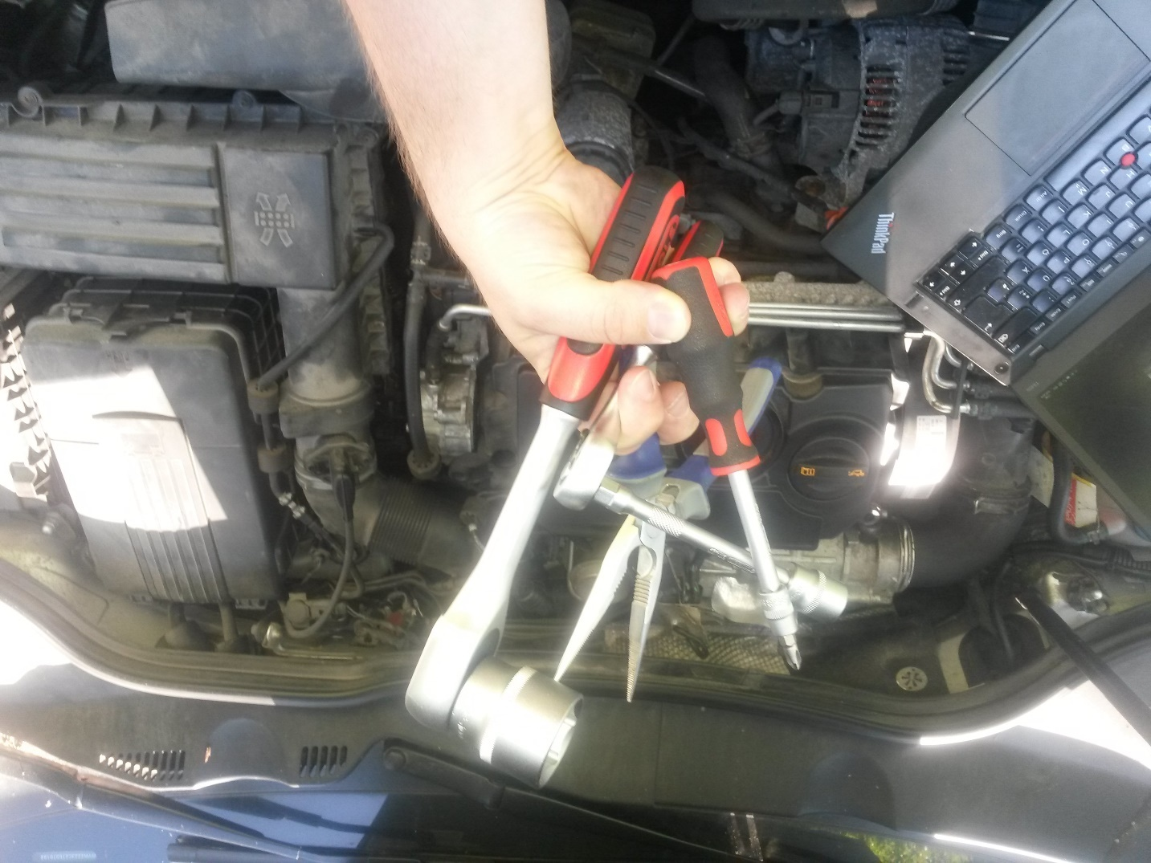
Notes:
How fixing things work:
Bring ALL your tools
Use the wrong one
Use another wrong one
Get a tool that works somehow
Scream and insult cold hard metal
Main problems:
People do not know what kind of special tooling they require …
… or how to use it.
Manuals always are in the way (on laptop screen, paper falling down, ….)
Unclear instructions
No free hands
Solution: Use AR HMD devices! (like Hololens and Meta 2)

Slide 3
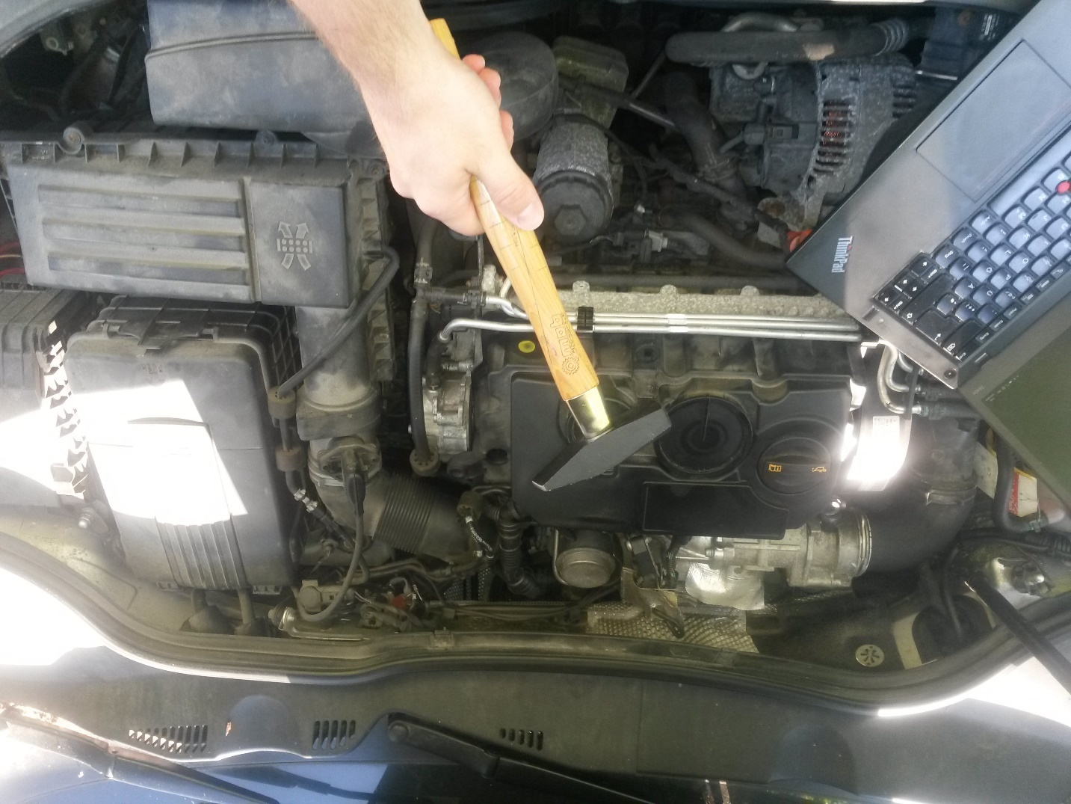


Slide 4
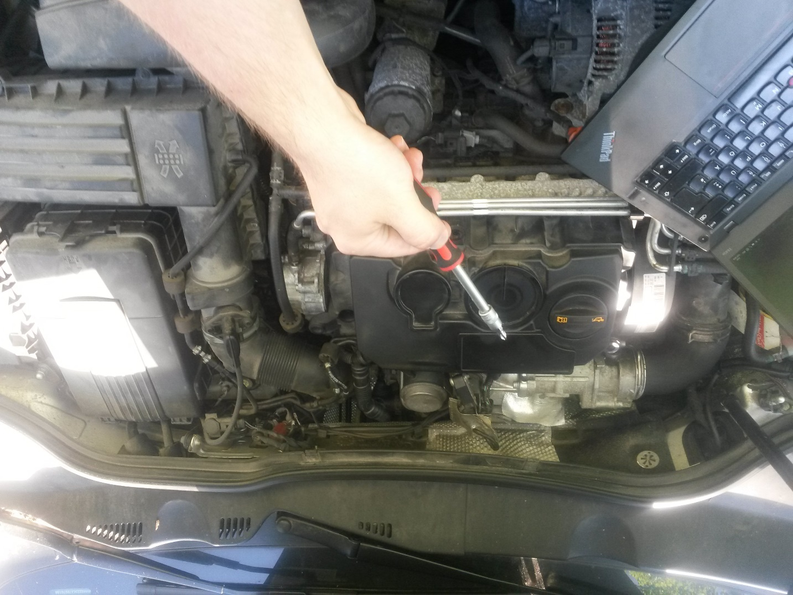


Slide 5
Who is involved?
Experts
Manufacturer
uFixit
End User / Fixer
Notes:
Which parties are involved?
End User: has a problem, wants to fix it as fast and cheap as possible
Fixer: Guy that provides easy to follow
Manufacturer:

Slide 6



Using a manual
Preparation
Diagnosis
Repair
diagnose
preparation
repair
Notes:
For whom?
End user with AR device
This can be customer or workshop personal, used in school teaching electronics, …..
Simple step-by-step tutorial
Get the right tool
Show user how it‘s done
Wait for him or her to finish
Go back to 1.
Transitioning by
gesture
voice command
picking up the tool used in the next step
=> Most importantly: Keep hand free to work!

Slide 7
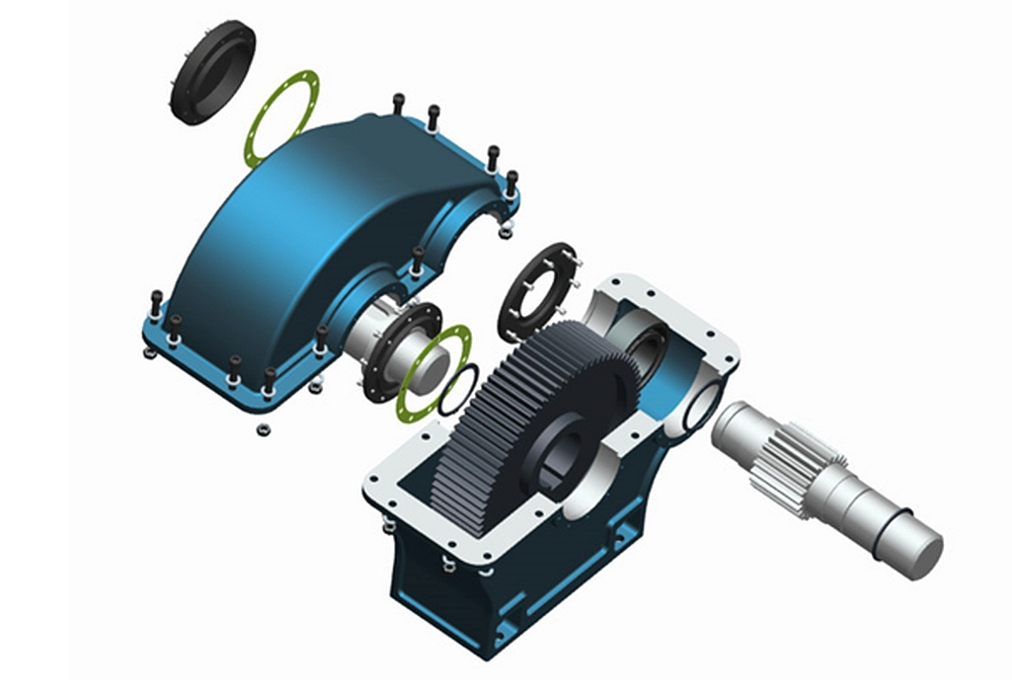
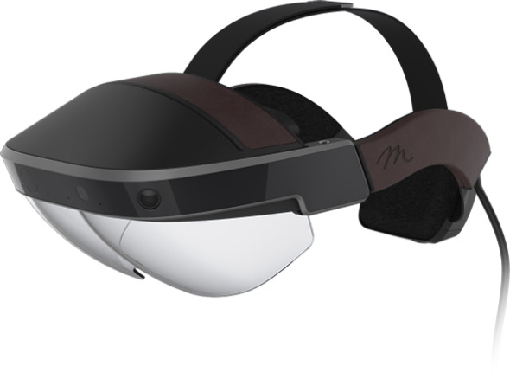
Creating a manual
AR device
CAD software
Notes:
CAD software
Animation
Extended highlighting

Slide 8


Improve a manual
Feedback
Fork and Publish
Notes:
General feedback:
Make suggestions
Rate tutorial
Fork and push improvements upstream!
For example: Amazon

Slide 9

Live support

Slide 10
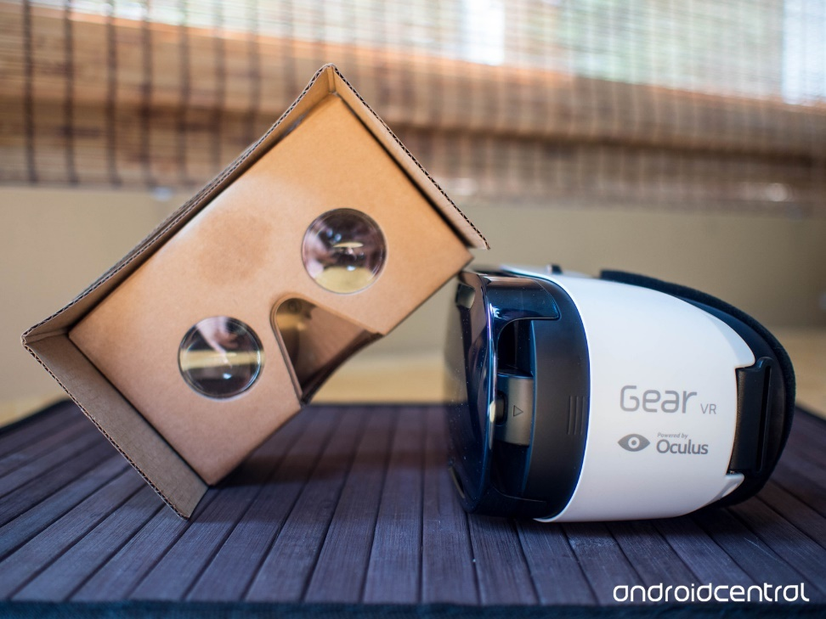
Hardware
High resolution camera
Microphone
Hand free
Portable

Slide 11
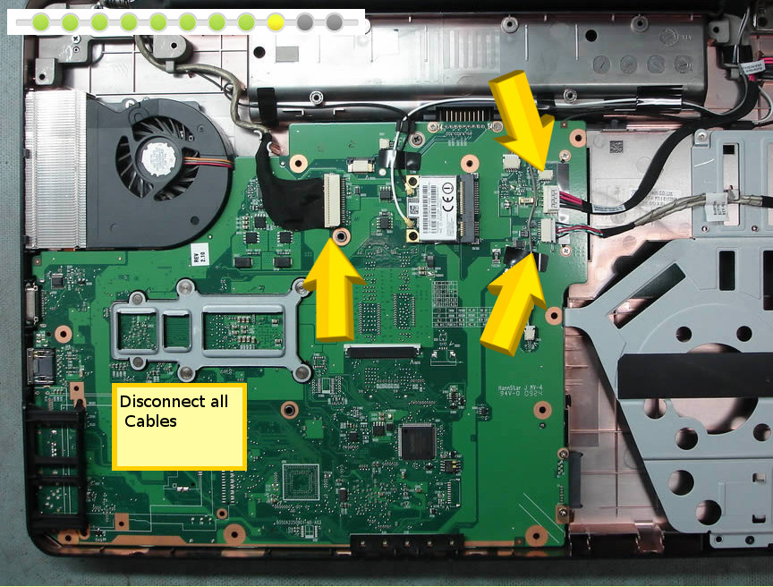
Expert generated guide

Slide 12




Printed annotation templates

Slide 13
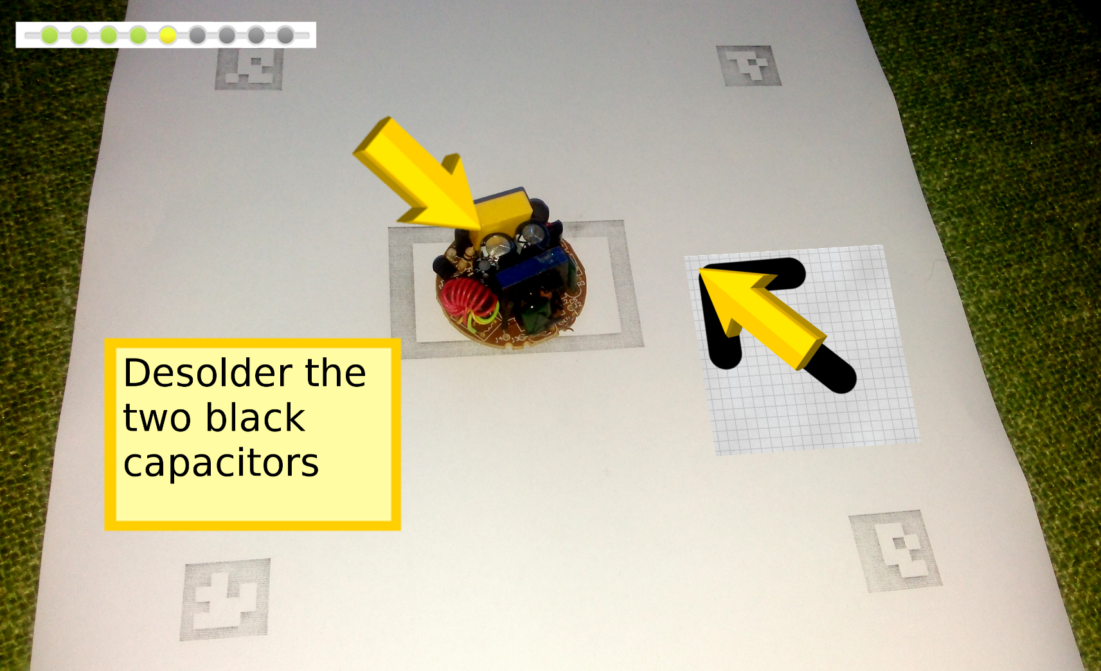
Assisted tracking

Slide 14
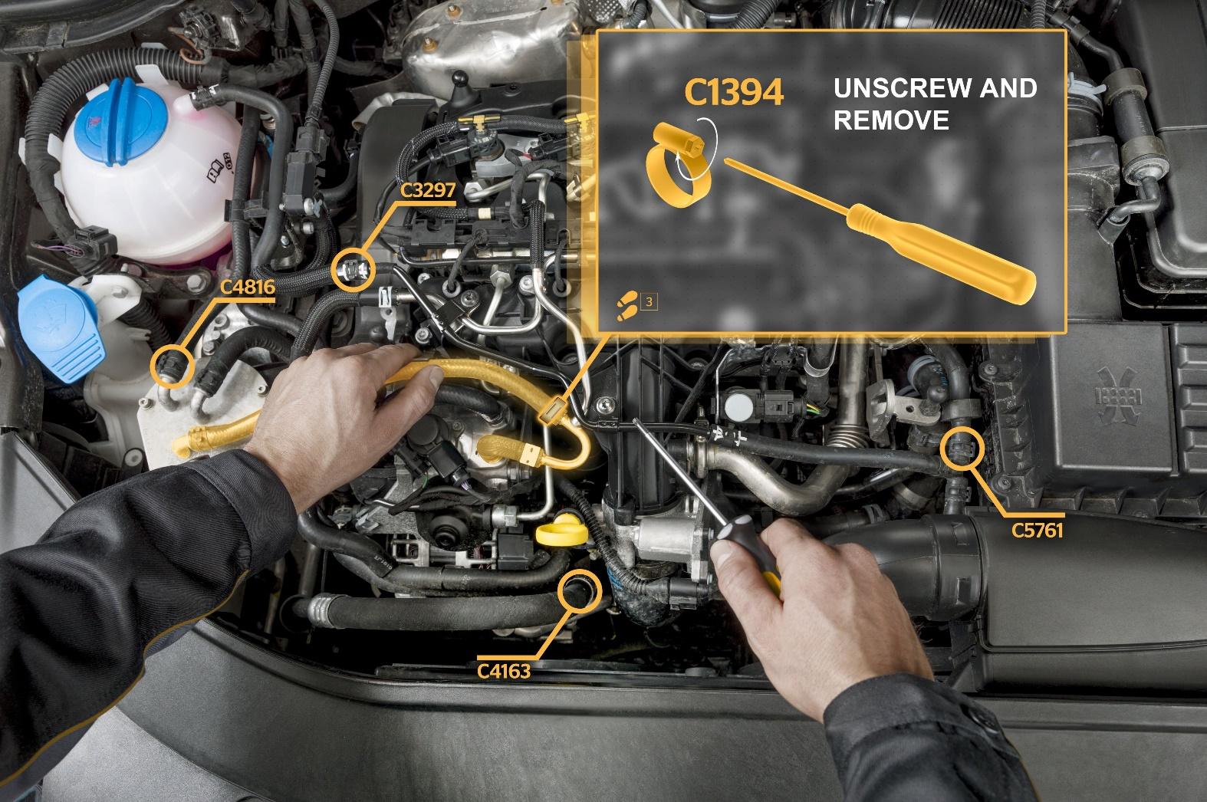
CAD model integration

Slide 15
Market Situation: SWOT Analysis
Strengths
Weaknesses
New Business idea
Talented developers
Lack of experience
First startup for all founders
Opportunities
Threats
No direct competitors
Several potential clients
Market volatility
AR technology not mature yet

Slide 16
Road Map
App for Fixers and Experts
Platform for manufactures
Community building

Slide 17
Capital Costs
BREAK EVEN
Capital costs | Costs for first 2 years
Administrative founding costs | 100 €
Office | 56.000 €
Marketing | 182.000 €
AR Development Hardware | 10.000 €
Server | 8.000 €
Total | 256.100 €

